Slide 1
Summer Fellowship Workshop
For students interested in the:
Wake Forest Research Fellowship
Wake Forest Arts & Humanities Fellowship
Richter Scholars Program
Sponsored by: The Undergraduate
Research and Creative Activities Center
(URECA)
http://ureca.wfu.edu/resources-for-students

Slide 2
Welcome
Today:
We will introduce the opportunities for summer scholarship offered at Wake Forest.
We will briefly outline the steps involved in actively seeking grant or foundation dollars.
We will learn a little bit about human subject research regulations.
We will break up into groups to learn more about applying for and participating in each program.

Slide 3
Welcome
Today:
We will introduce the opportunities for summer scholarship offered at Wake Forest.
We will briefly outline the steps involved in actively seeking grant or foundation dollars.
We will learn a little bit about human subject research regulations.
We will break up into groups to learn more about applying for and participating in each program.

Slide 4
Wake Forest Research Fellowship
A collaborative project under the mentorship of a Wake Forest faculty member.
Open to all academic divisions.
Award includes $4000 stipend, summer housing (if requested), and up to $500 in supplies for the project (if requested).
Must be at least 10 wks in length across the summer semesters
Students may not take summer courses in conjunction with a WFRF
Applications due February 10th, 2023

Slide 5
Wake Forest Arts & Humanities Fellowship
A collaborative project under the mentorship of a Wake Forest faculty member.
Open to students with mentors in Division I, II, or III.
Award includes $2000 stipend, summer housing for 1 session (if requested), and up to $500 in supplies for the project (if requested)
Must be at least 5 wks in length.
Students may not take summer courses during the same summer session as the WFA&HF
Applications due March 15th, 2023

Slide 6
Richter Scholarship
Designed to support “life-changing experiences”
Independent, individual scholarly projects
Off campus & internationally-focused.
Award allows for a budget of up to $6000, including money for travel and living expenses.
No fees paid may be paid to other institutions or programs
Not for equipment
Human subjects research discouraged
Good mentoring advice a key to success
Applications due February 14th, 2023

Slide 7
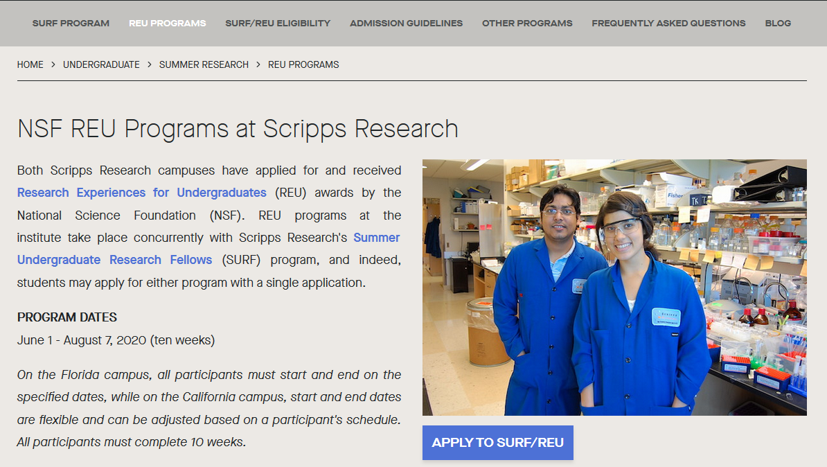
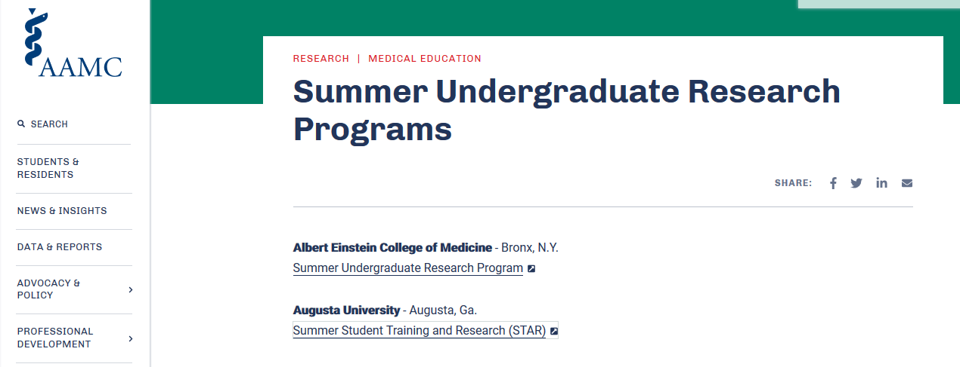
External Opportunities.
These are not the only opportunities that students have to get research and scholarly experiences in the summer months.
Many other schools and government institutes offer similar programs.
STEM programs can be found by doing web-based searches for REU (Research Experiences for Undergraduates) or SURF (Summer Undergraduate Research Fellows) programs.
https://education.scripps.edu/undergraduate/summer-research/surf-program/
https://www.aamc.org/professional-development/affinity-groups/great/summer-undergrad-research-programs
Association of American Medical Colleges- List

Slide 8
After the project is done:
Any student who has earned a WFU fellowship must present a poster or talk on the project at Wake Forest Research Day (family weekend)
Additionally, the college supports the travel of students to professional conferences with their mentors. The STARR Travel Grant provides up to $700 for students to present their mentored scholarship at discipline-specific conferences. The application can be found here: http://ureca.wfu.edu/resources-for-students

Slide 9
Today:
We will introduce the opportunities for summer scholarship offered at Wake Forest and elsewhere.
We will briefly outline the steps involved in actively seeking grant or foundation dollars.
We will learn a little bit about human subject research regulations.
We will break up into groups to learn more about applying for and participating in each program.

Slide 10
Seeking funding support for research, education, or creative activities.
Examples:
A scientist wishes to ask for federal dollars to support a research project.
A teacher/educator/parent applies for state dollars to develop a new educational program, to buy computers, or to build a new classroom.
An artist learns that the city is commissioning a piece of artwork to be featured in City Hall.

Slide 11
What steps are involved?
In an ideal world, we would:
1) Have a great idea!
2) Write a proposal to fund the idea!
3) Submit the proposal and have it funded!
Note: None of these steps is trivial, BUT, we are much more likely to achieve the final goal IF we add two more steps to the process.

Slide 12
What steps are involved?
To maximize our success, we should:
1) Have a great idea!
2) Research possible funding sources.
3) Write a proposal based on our idea AND our research of the funding source!
4) Review the proposal critically based on our research.
5) Submit the proposal and have it funded!
Although steps #2 & #4 are NOT the most fun steps, they may be the most critical to a successful application.

Slide 13
Walking through the steps
To maximize our success, we should:
1) Have a great idea!
2) Research possible funding sources.
Who might fund your type of problem/question?
What kind of proposals have they funded in the past?
If possible, get samples of successful applications.
What percentage of proposals are actually funded?
How are the proposals evaluated?
If possible, get the score sheet!

Slide 14
Walking through the steps
To maximize our success, we should:
1) Have a great idea!
2) Research possible funding sources.
3) Write a proposal based on our idea AND our research of the funding source!
4) Review the proposal critically based on our research.

Slide 15
What do I mean: Review the proposal?
Since we did our homework, we KNOW how our proposal will be evaluated.
The BEST thing you can now do is to have someone evaluate your proposal based upon the homework.
There are several ways to accomplish this.
Use your mentors, friends, and colleagues.
Consider holding a “mock review” session.

Slide 16
What steps are involved?
To maximize our success, we should:
1) Have a great idea!
2) Research possible funding sources.
3) Write a proposal based on our idea AND our research of the funding source!
4) Review the proposal critically based on our research.
Edit the proposal to reflect the feedback!
5) Submit the proposal and have it funded!

Slide 17
Questions?

Slide 18
Welcome
Today:
We will introduce the opportunities for summer scholarship offered at Wake Forest and elsewhere.
We will briefly outline the steps involved in actively seeking grant or foundation dollars.
We will learn a little bit about human subject research regulations.
We will break up into groups to learn more about applying for and participating in each program.

Slide 19
Human Subject Research
Jeanie Baird, MPA, CIP
Associate Director for Human Research Protection
irb@wfu.edu
For more information regarding human subject research and IRB requirements, please visit:
http://research.wfu.edu/irb/

Slide 21
Today:
We will briefly outline the steps involved in actively seeking grant or foundation dollars.
We will introduce the Summer Research Fellowship and the Richter Scholars Program.
We will learn a little bit about human subject research regulations.
We will break up into groups to learn more about applying for and participating in each program.

