Slide 1
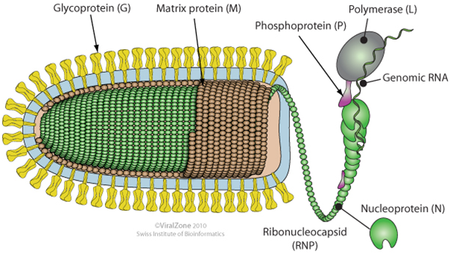
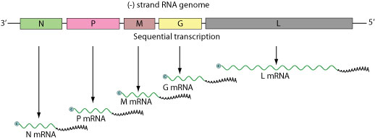
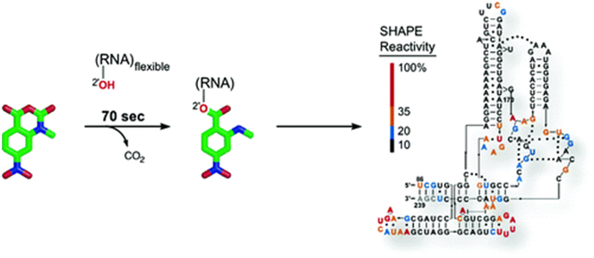
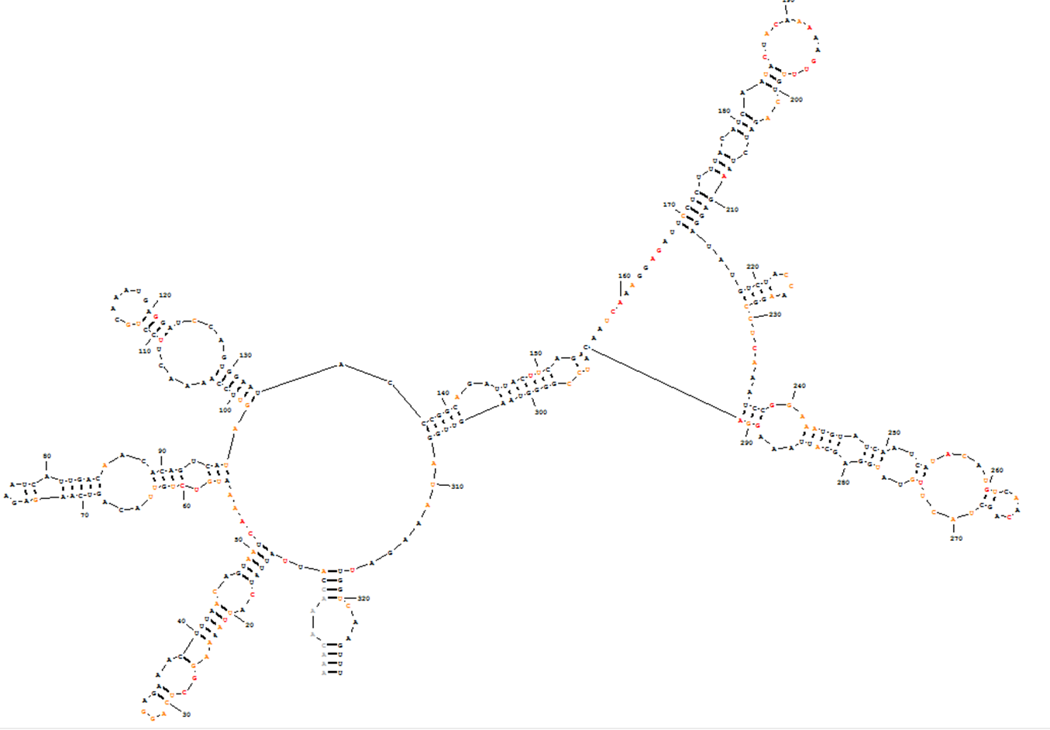
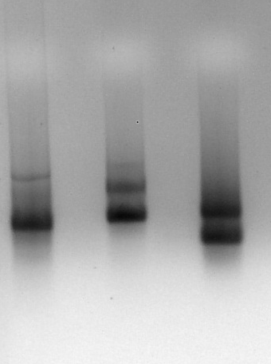
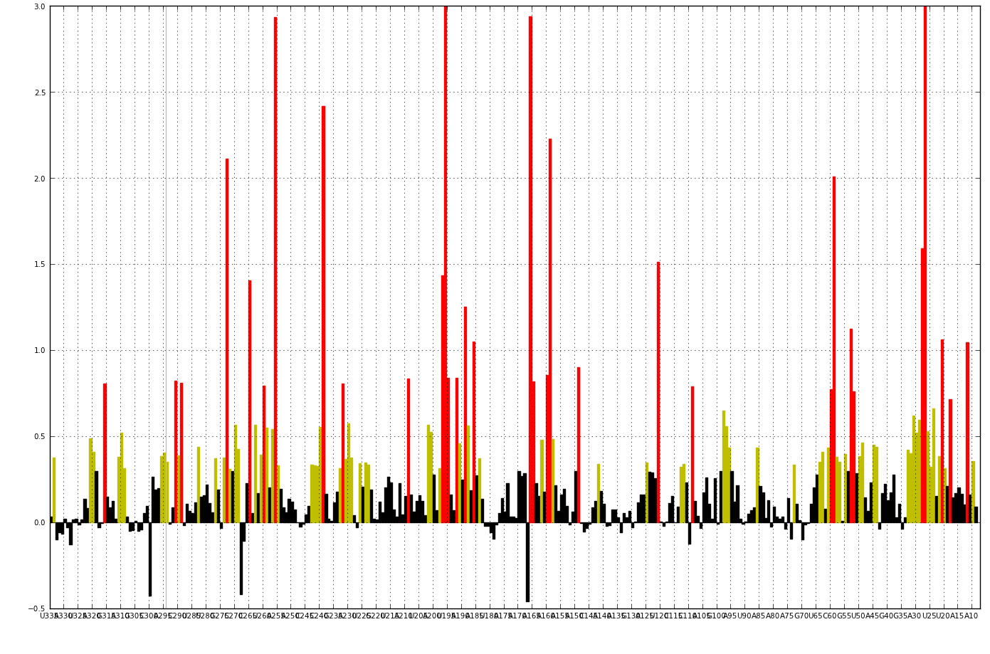
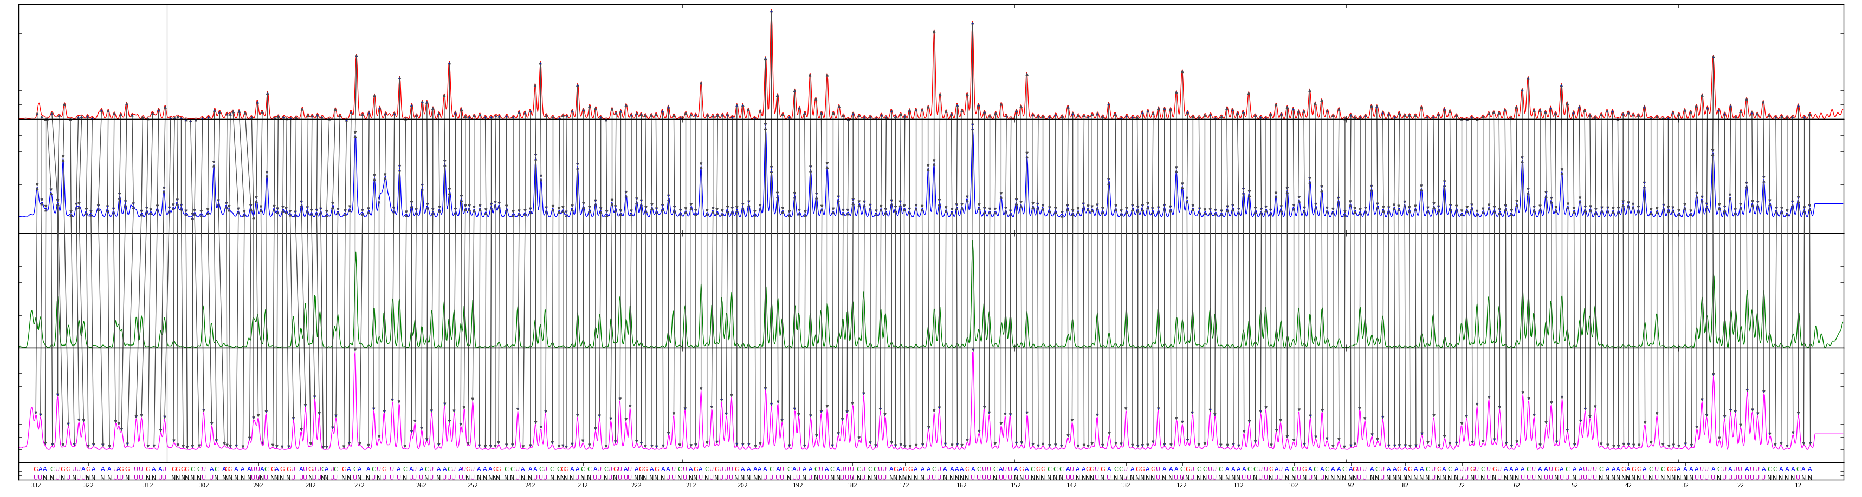

SHAPE analysis of viral RNA transcripts
Daniel Hodges, Tara Seymour, Emily Spurlin, and Rebecca Alexander
Department of Chemistry, Wake Forest University
Vesicular stomatitis virus (VSV) is a member of the Rhabdoviradae virus family. Viruses in this family are negative sense single-stranded RNA viruses. Rabies, Ebola, and influenza A are examples of other viruses in this family but these viruses are infectious and potentially deadly to humans, making them difficult to study. Thus the cellular biochemistry of VSV is fundamentally interesting as it may serve as a model for infectious negative sense single-stranded RNA viruses. Another reason VSV is of interest is because there is evidence that it triggers destruction of cancer cells. VSV RNA is transcribed by the infected host while also inhibiting host transcription, leading to viral replication and host cell death. The goal of this project is to use SHAPE (Selective 2′-Hydroxy acylation Analyzed by Primer Extension) analysis of VSV genomic RNA to determine the structure of the VSV genome. We have demonstrated the feasibility of this goal by SHAPE probing in vitro transcripts of both sense and anti-sense VSV RNA.
VSV Structure
Genome Organization
Figure 1. Image of a Rhabdoviradae type virus. Shown are the key proteins encoded by the viral genome. (Source: ViralZone. www.expasy.org/viralzone, Swiss Institute of Bioinformatics)
Figure 2. Image of viral genome and relative sizes of encoded proteins and mRNA. (Source: ViralZone. www.expasy.org/viralzone, Swiss Institute of Bioinformatics)
Methods
PCR sequence of interest from plasmid (Figure 3)
Add T7 promoter to PCR template
Transcribe PCR template
Perform Sequence Reactions using unmodified RNA to obtain RNA sequence
Perform structure reactions using 1M7 modified RNA (Figure 4)
Use SHAPE to identify where the RNA is structurally flexible
Construct RNA structure cartoon using gathered information and RNAStructure5.3 program
1-methyl-7-nitroisatoic anhydride (1M7)
Figure 4. Schematic of structure reactions. 1M7 is added to flexible hydroxyl groups of the RNA and relative reactivity is measured so that structure can be deduced. Mortimer SA, Weeks KM. Time-Resolved RNA SHAPE Chemistry. J ACS. American Chemical Society. 2008;130(48):16178-16180.
Figure 3. Process by which VSV RNA was obtained for study.
Results
Results (Fig 6-8) shown correspond to anti-genomic encoded N protein indicated as in Figures 2 & 5.
Anti-Genomic N
1,326 bp
Figure 5. Agarose gel electrophoreses of 3 pieces of purified RNA transcript of VSV genome.
Genomic N
1,326 bp
Genomic M
831 bp
Figure 7. Relative reactivity of 1M7 at each nucleotide using SHAPE.
Figure 8. RNA structure of anti-genomic encoded N protein based on SHAPE analysis.
Figure 6. RNA sequence using QuShape.
Next Steps:
References:
Acknowledgements:
Isolate RNA from live virus for study
Perform SHAPE analysis for entire VSV genome
Chen, Z., Green, T.J., Luo, M. & Li, H. Visualizing
the RNA Molecule in the Bacterially Expressed
Vesicular Stomatitis Virus Nucleoprotein-RNA
Complex. Structure 12, 227-235 (2004).
Mortimer S.A., Weeks K.W. Time-resolved RNA
SHAPE chemistry: quantitative RNA structure
analysis in one-second snapshots and at single-
nucleotide resolution. Nature. 4, 1413-1421
(2009).
Wake Forest Research Fellowship Program, Dr. Kevin Weeks, Dr. Fetullah Karabiber, Jen McGinnis, Phil Homan, Veronica Casina

