Slide 1
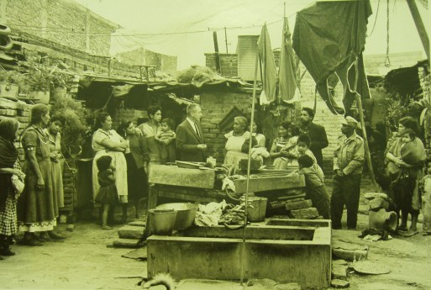
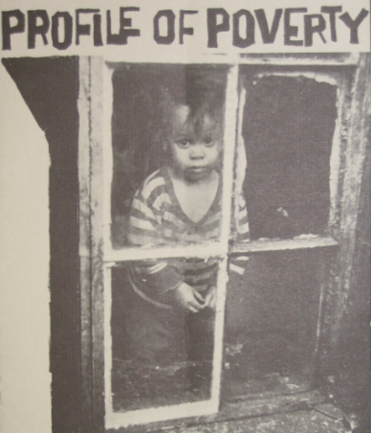
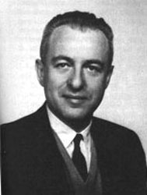
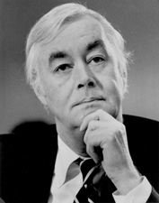
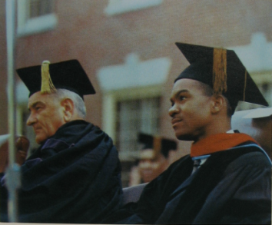
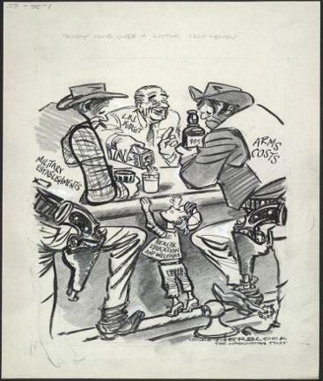
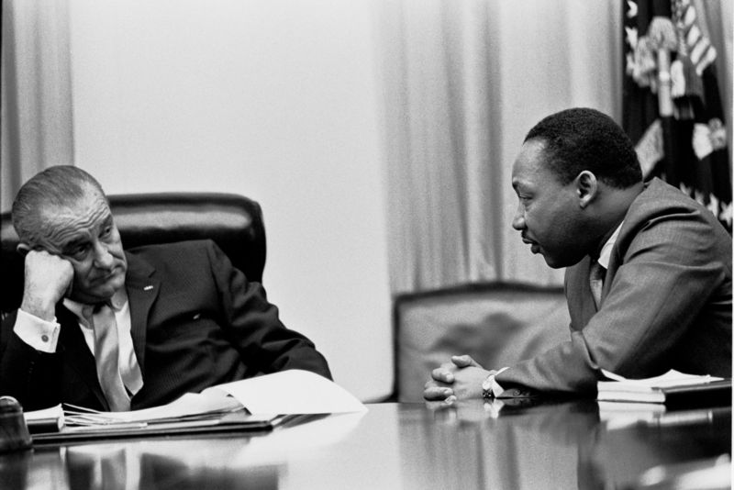
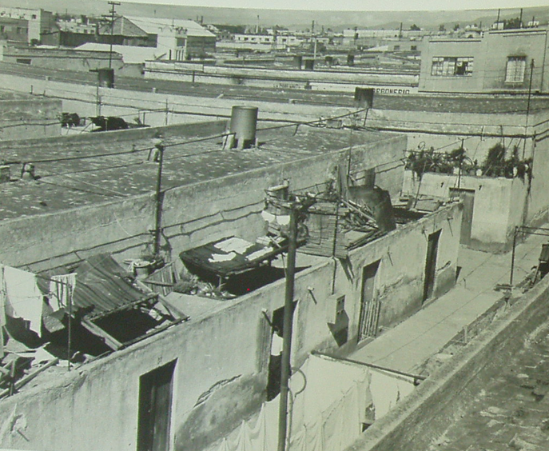
The Theories of Oscar Lewis and the War on Poverty
Melissa M. Velarde
Wake Forest University History Department
Abstract:
American anthropologist Oscar Lewis is most prominently known for his revolutionary concept of “the culture of poverty.” During his career, Lewis studied peasants and the poor living in Mexico, Cuba, Puerto Rico, and New York from the 1940’s to the 1960’s. Lewis’s culture of poverty theory helped shape America’s War on Poverty. In fact, it can be said that Lewis’s theory of the culture of poverty was the conceptual backbone for the War on Poverty during the 1960’s and 1970’s.
Oscar Lewis conducting research in Mexico.¹
Culture of Poverty:
There are economic, social, and psychological traits that define the culture of poverty. Lewis specifically described the culture of poverty through a set of seventy interrelated traits. The culture of poverty can be explained as, “The way the poor adapted to their environment, the strategies they used to care with feelings of ’hopelessness and despair,’ a result of their ‘realization of the improbability of achieving success’ in class-stratified cities undergoing rapid technological change.” ³
Flyer from 1965 Photo Exhibit on Poverty.²
War on Poverty:
The War on Poverty began in 1964 during President Lyndon B. Johnson’s term. One of the most influential people in constructing the War on Poverty programs was Daniel P. Moynihan, an advisor to President Johnson. His influence on the War on Poverty can be traced to his authorship of The Negro Family: The Case for National Action. While nowhere in The Negro Family does Moynihan mention Lewis, it is obvious that Moynihan was influenced by Lewis’s theory. As University of Pennsylvania history Professor Michael Katz observes, despite the failure to reference Lewis, “Nonetheless, informed readers could not miss the striking parallels between Lewis’s culture of poverty and Moynihan’s cycle of poverty; ‘subculture. . . of the Negro American’; and ‘tangle of pathology’ . . .”⁴ Moynihan in effect picked aspects from the culture of poverty theory and applied them to American poverty, while completely ignoring or leaving out other aspects. Arguably, Moynihan’s focus on family structure and race narrowed Lewis’s claims, and thus misapplied the culture of poverty theory to American poverty.
Oscar Lewis.⁵
Daniel Moynihan.⁶
1965 War on Poverty Cartoon.⁸
President Johnson at Howard University.⁷
Research:
With the funding of a Carswell Summer Research Grant, I conducted my research over the summer at the Library of Congress, Oscar Lewis archives at the University of Illinois Champagne-Urbana, and the Lyndon B. Johnson Library in Austin, Texas.
Casa Grande, one of the slums Lewis studied in Mexico.⁹
President Johnson and Martin Luther King, Jr.¹⁰
At the Oscar Lewis Archives, the Archives building, and at the LBJ Library.

